Slide 1
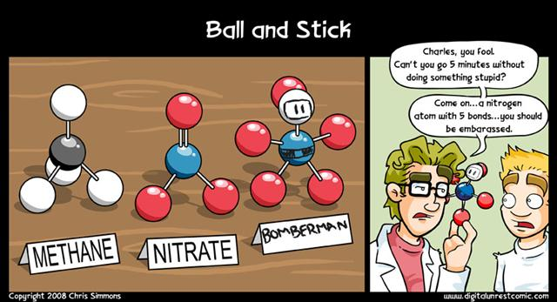

Slide 2
Review
Write an ionic equation for:
Solid sodium hydroxide is treated with dilute ethanoic acid.

Slide 3
Review
Draw electron dot diagrams for:
HCl
CO2
SO2
SO3
H2O
NH3
CH4

Slide 4
A2 Chemistry
Molecular Shapes

Slide 5
Learning Intentions
the valence shell electron pair repulsion (VSEPR) theory and Lewis structure diagrams can be used to explain, predict and draw the shapes of molecules

Slide 6
Success criteria
Describe features (bonds, atoms) of molecules of each shape
Use VSEPR Theory to explain bond angles
Define lone pairs and bonding pairs
Draw dot diagrams for covalent molecules and classify them according to their shape.

Slide 7
Key terms
valence shell electron pair repulsion (VSEPR) theory
Lewis structure diagrams
lone pairs
linear
bent
triangular planar
pyramidal
tetrahedral

Slide 8


Slide 9
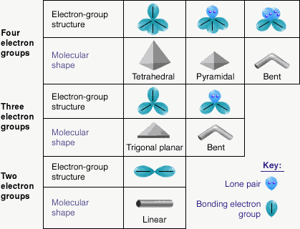
VSEPR Theory
Bonds and non-bonding electrons will repel each other, which affects the angles of bonds.
Lewis structures show the shapes of molecules that result

Slide 10
Shapes of molecules
molecular shapes are determined by
the number of atoms
the number of bonds from the central atom (if more than two atoms)
the number of lone pairs (non-bonding electrons) on the central atom only

Slide 11
Linear
2 atoms only
3 atoms where the central atom has no lone pairs
Bond angle 180º

Slide 12
Bent or v-shaped
3 atoms
one or two lone pairs on the central atom
bond angle 120º (for one lone pair)
or 109º (for two lone pairs)

Slide 13
Triangular planar
4 atoms
central atom has no lone pairs
bond angle 120º

Slide 14
Pyramidal
4 atoms
Central atom has a lone pair
bond angle 109º

Slide 15
Tetrahedral
5 atoms
central atom has no lone pairs
bond angle 109º

